Slide 1
Lab Temperature Monitoring POC
Chris Kebriti
LabOps 2016

Slide 2
Problem Statement
Need a cheap reliable and effective method of monitoring lab temperatures and receive notifications before temperatures reach critical levels so lab admins can react

Slide 3
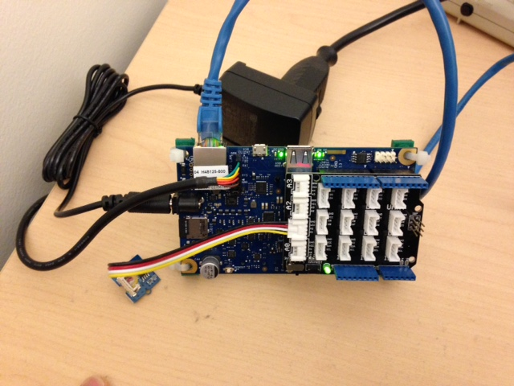

Hardware Used
Galileo IoT with temperature sensor
Webhost Server

Slide 4
What was done
Galileo IoT: Created python script to send temperature reading periodically to server
Server:
Listen for UDP packets, save temp reading to disk
Dashboard: Generate HTML for webhost server to display current temp reading and graph historic values
Create cron job to run periodically and send text alerts if average of last few readings exceed threshold value

Slide 5
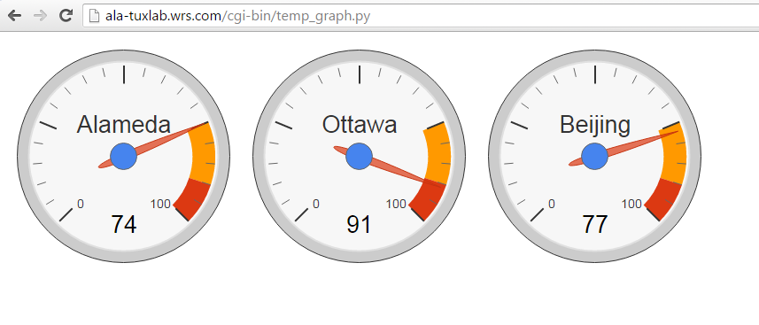
Webhost Server
Webpage showing current temperature values (disclaimer: sensors deployed only in Alameda)
Dashboard automatically refreshes with most recent values

Slide 6
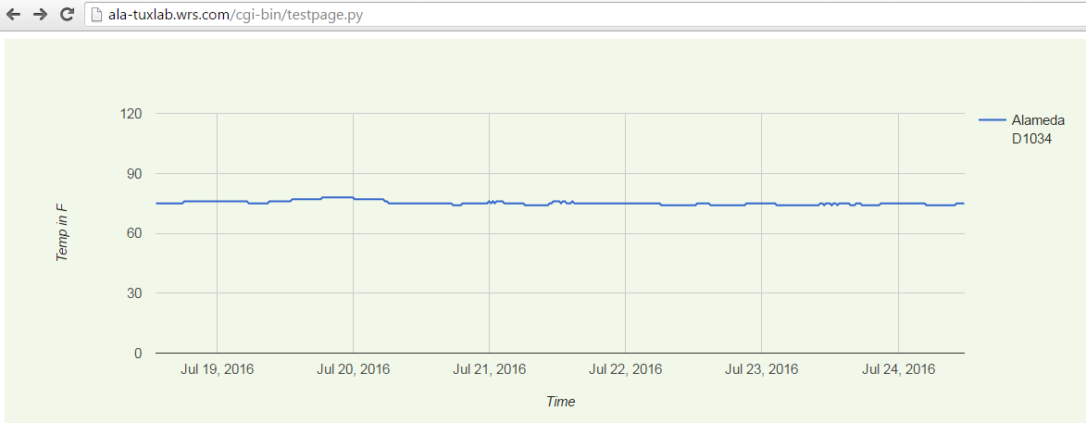
Webhost Server
Graph showing temperature over time

Slide 7
Summary
We can very cheaply and effectively monitor ambient temperature values in the labs and be alerted about cooling problems early on to allow lab admins to react before critical infrastructure is damaged and customers are impacted

